Slide 1


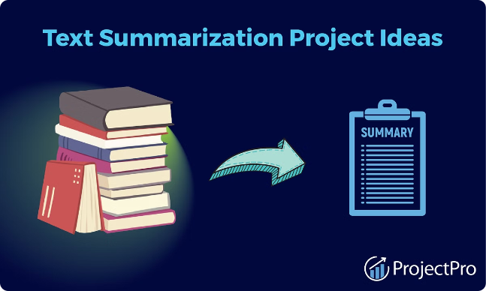
Project Title:
Text summarization using
text-to-text transfer transformer
Team-Abhinav Khatiyan
Aman Sharma
Mohd Shariq
Mehtab Shaikh
Guided By:
Assistant Prof. Abhishek Kumar

Slide 2

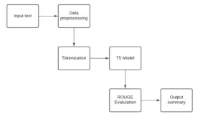
Problem Statement:
In today's information-rich world, the abundance of textual data makes it increasingly challenging for individuals to consume and extract meaningful insights efficiently.

Slide 3

Introduction to Text Summarization
Definition
Purpose
Text summarization is the process of condensing a lengthy document or article into a concise and informative summary, capturing the key points and essential information.
Summarization helps readers quickly grasp the main ideas and salient points of a text, saving time and effort compared to reading the full document.
Applications
Summarization has diverse applications, from news article summaries to academic paper abstracts, making large volumes of text more accessible and digestible.

Slide 4

Challenges in Text Summarization
Capturing the essential meaning and key information from long, complex documents while preserving coherence and context.
Handling ambiguity and linguistic nuance to accurately summarize the intended message of the source text.
Developing abstractive summarization models that can generate novel, human-like sentences rather than just extracting sentences from the original text.
Summarization models often struggle to retain the core meaning and context of the source text, especially for complex or nuanced content.

Slide 5

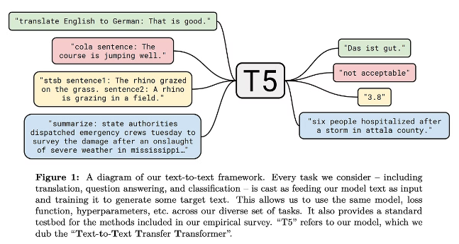
Overview of Text-to-Text Transfer Transformer (T5)
The Text-to-Text Transfer Transformer (T5) is a powerful deep learning model developed by researchers at Google AI. It is a generative language model that can be fine-tuned for a wide range of text-to-text tasks, including summarization, translation, and question answering.
Key Features of T5:
1.Unified Text-to-Text Framework:
All tasks are converted into text generation problems. For example:
Input: Summarize: The article discusses...
Output: The main point is...
This framework allows seamless adaptability to multiple NLP tasks.
2.Transformer Architecture:
Built on the Transformer model, it utilizes an encoder-decoder structure for efficient processing of text data.
The encoder reads and understands the input text, while the decoder generates the output text.

Slide 6
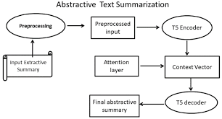
T5 Architecture and Model Components
The Text-to-Text Transfer Transformer (T5) is a multi-task neural network model designed for a wide range of natural language processing tasks. The core architecture is based on the popular Transformer model, with encoder and decoder components.
T5 utilizes a prefix-based approach, where the input and output are both text sequences. This allows the model to be fine-tuned on diverse tasks by simply rephrasing the input and output as text.

Slide 7


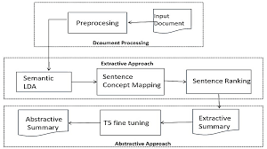
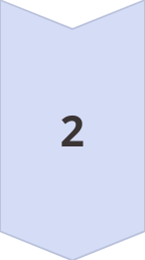

T5 Pre-training and Fine-tuning
Pre-training Stage
T5 is pre-trained on a massive corpus of text data, allowing the model to learn general language understanding and generation capabilities.
Unsupervised Pre-training
The pre-training process is unsupervised, using self-supervised objectives like masked language modeling to learn contextual representations.
Fine-tuning for Summarization
Once pre-trained, T5 is fine-tuned on specific summarization datasets, allowing it to adapt and specialize for the task at hand.

Slide 8
Evaluation Metrics for Text Summarization
1
ROUGE
The ROUGE metric evaluates summary quality by comparing it to reference summaries, measuring overlapping n-grams.
2
BLEU
BLEU assesses the similarity between the generated summary and high-quality human-written references.

Slide 9
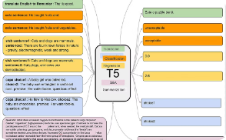
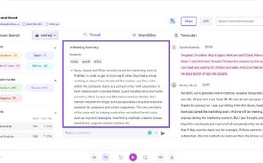
Applications of T5 in Text Summarization
Summarizing News Articles
Summarizing Academic Papers
Summarizing Customer Reviews
Summarizing Meeting Transcripts
T5 has shown impressive performance in summarizing long-form news articles, capturing the key points and insights while reducing the text to a concise, readable summary.
The versatility of T5 allows it to effectively summarize complex academic papers, extracting the core ideas, findings, and conclusions to aid researchers and students.
T5 can quickly digest lengthy customer reviews and produce high-quality summaries, helping businesses better understand customer sentiment and feedback.
T5 can assist in summarizing meeting transcripts, distilling key action items, decisions, and insights to improve productivity and information retention.

Slide 10
Limitations and Future Directions
Despite the impressive performance of T5 in text summarization, there are still limitations and opportunities for future development.
The model's reliance on large pre-training datasets can be a challenge for low-resource languages or domains.
Additionally, further research is needed to improve the factual accuracy and coherence of generated summaries.
Looking ahead, integrating T5 with other advanced techniques, such as reinforcement learning or generative adversarial networks, could lead to even more powerful and versatile summarization models.
Exploring multimodal summarization, which combines text and visual information, is another promising area for future exploration.

Slide 11
References
©2020 Colin Raffel, Noam Shazeer, Adam Roberts, Katherine Lee, Sharan Narang, Michael Matena, Yanqi Zhou, Wei Li, and Peter J. Liu.
Wang, M.; Xie, P.; Du, Y.; Hu, X. T5-Based Model for Abstractive Summarization: A Semi-Supervised Learning Approach with Consistency Loss Functions. Appl. Sci. 2023, 13, 7111. https:// doi.org/10.3390/app13127111
]Jakob Uszkoreit, “Transformer: A Novel Neural Network Architecture for Language Understanding”, Google Research 2017 .

Slide 12
Thank You!

